Slide 1

AUTO TRACKER

Slide 2
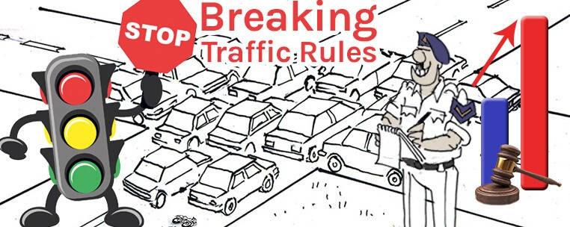
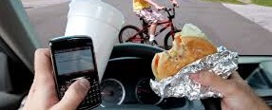
PROBLEM STATEMENT
Record of Traffic Rules Breaker
Careless Driving

Slide 3
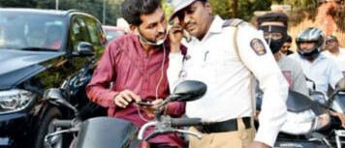
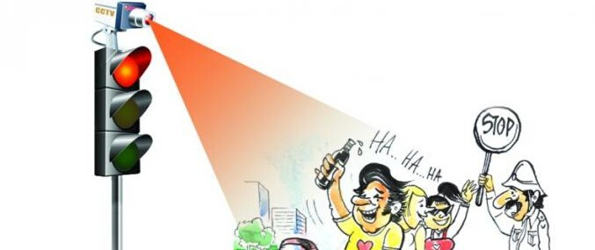
Careless Police
Flaws of Camera System

Slide 4
Solution
Maintaining the record of traffic rule breakers using local database.
Solving problems of careless driving and police
Using geo-fencing instead of camera system
Tracing life location of vehical using batch geocoding

Slide 5

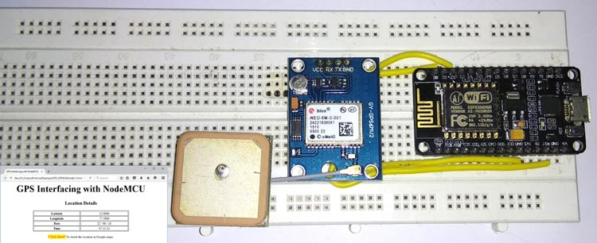

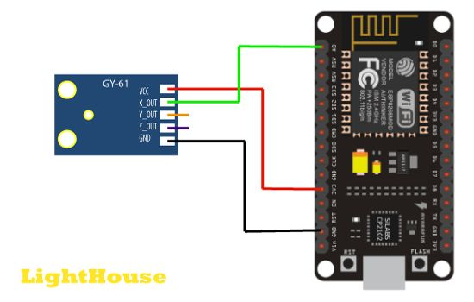

Client Server Architecture
HARDWARE
IMPLEMENTATION
Node MCU
GPS
Gyroscope- Accelerometer

Slide 6
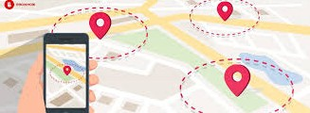
Geofencing and RFID for monitoring and visualising the vehicle
1
2
3

Slide 7


Better then camera system
Give live location
Uses and Pros
Cost Effective
Monitoring and visualisation of vehicle tracking become easy

Slide 8
THANK YOU

